Slide 1
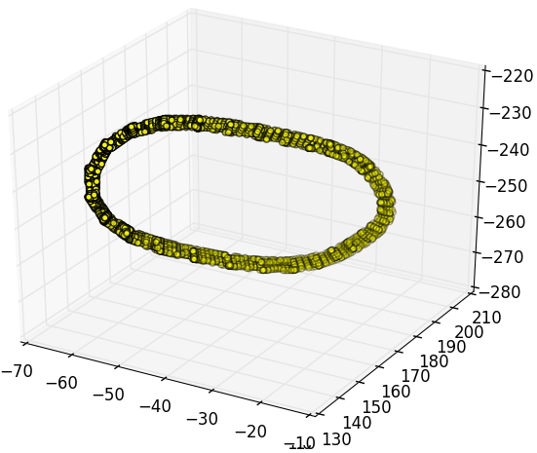
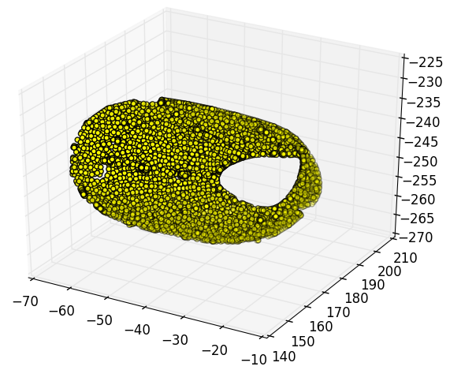
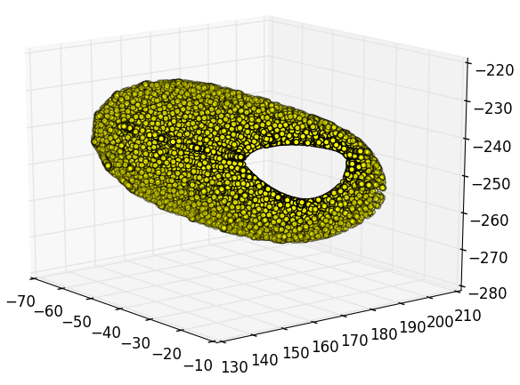
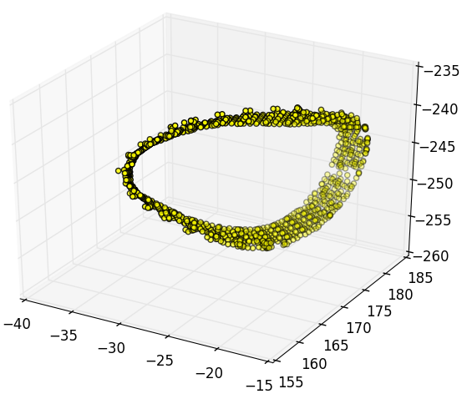
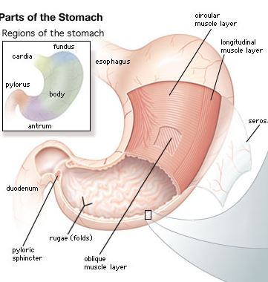
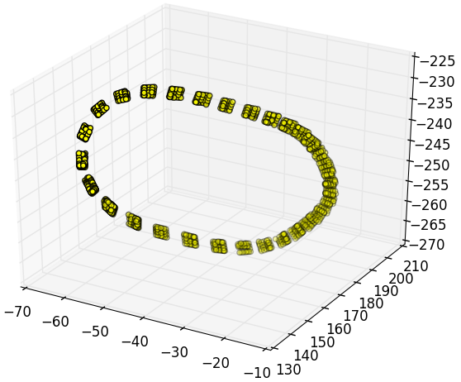
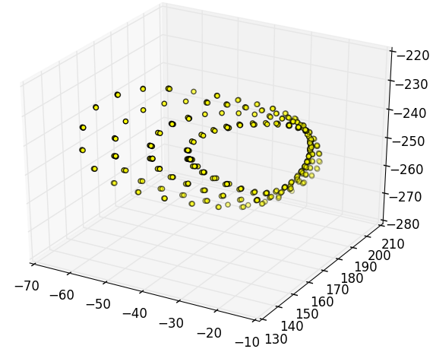
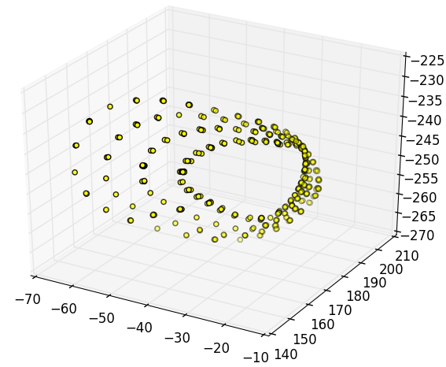
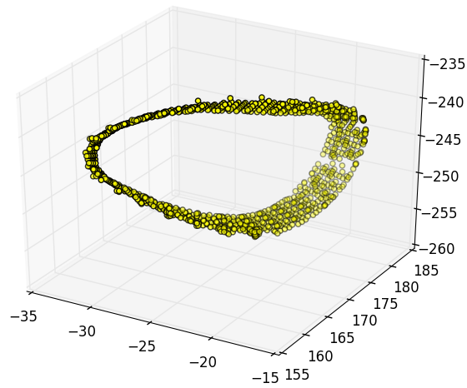
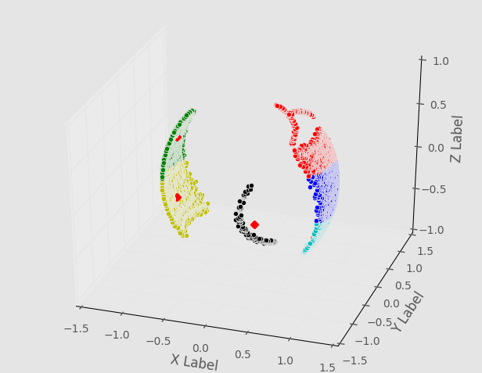
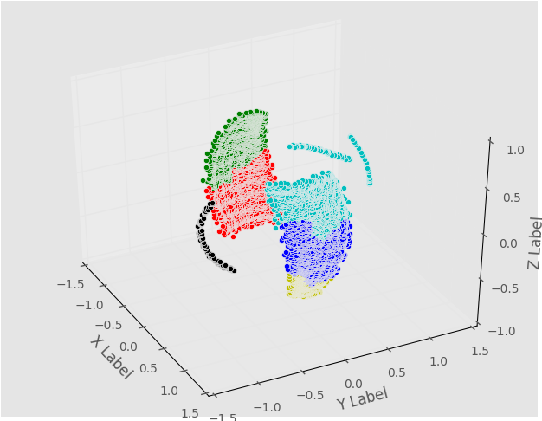
Generating the stomach fibers for Gastric Motility
Amogh Mishra, Dr. Shameer Sathar Auckland Bioengineering Institute, The University of Auckland, New Zealand
Aim
To generate the three stomach fibers to study the effect of electric activity on smooth muscle cells.
Background
Gastrointestinal motility is coordinated by slow waves generated by the interstitial cells of Cajal. Understanding the effects of the different muscle layer orientations on the underlying slow wave patterns is important to identify diagnostic and predictive tools for therapeutic purposes.
Method
Laplace Dirichlet equation in CHASTE framework is capable extracting the fiber information of the three layers. To perform this, classification of nodes on the faces of the geometry is required which was performed by:
Testing if the foot of projection of a node lies inside the triangle
Testing if the node itself lies in the 3D triangle test
K-means clustering, Agglomerative clustering
Results
1) Using Method 1 with a threshold value of 0.1. Threshold value is the acceptable distance between the foot of projection and the node to be classified for that face of the geometry.
Surface 1,2,3 and 4 corresponds to the scatter plot of the nodes classified for that surface respectively, for a geometry.
2) Using Method 1 and 2 both
3) Clustering
Conclusion
Test (1) alone was capable classified a considerable amount of points.
Test (1) and (2) together gave a harder restriction to classify the points. Hence, too less points were classified.
Clustering was incapable of classifying the nodes due to unequal blobs.
Surface 1
Surface 2
Surface 3
Surface 4
Surface 1
Surface 2
Surface 3
Surface 4
K means Clustering
Agglomerative Clustering

